Slide 1
Analyze the Behavior of Loan Property Customers
Rica Kesuma Mansyur
Portfolio

Slide 2
About the Project
01.
Business Insight
Overview
04.
02.
Conclusion
EDA
05.
03.
My Profile
06.
Describe the project of portfolio
Describe in a business way
Describe tentang pandangan sebagai data analyst
The results
Exploratory Data Analyst Steps
Here you could describe the topic of the section

Slide 3
About the Project
I conducted an analysis of the behavior and customer profiles at a bank that offers a loan program for property purchases. In this analysis, I will discuss several important aspects related to customer behavior and their profiles. To begin with, it is crucial to understand customer behavior within the context of property loans. I collected data on customers' loan history, including loan status, loan durations, and repayment success rates. This information helps to comprehend customers' payment patterns and predict potential credit risks. Additionally, I analyzed customers' demographic profiles, such as status, income, and occupation. This data is essential as it provides insights into customers' ability to repay loans and their financial risk. For instance, customers with higher incomes may have a better capacity to repay loans compared to those with lower incomes.

Slide 4
Overview
As a data analyst at a bank that provides loan services for property purchases, the customers of this program are existing bank account holders. The data includes all personal information of the customers as well as their credit history within a specific period. My task is to analyze the behavior of customers who apply for loans at the bank.

Slide 5
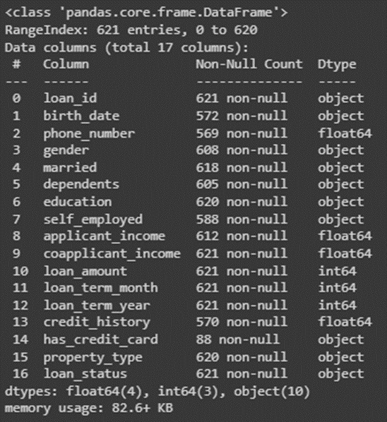
Dataset
There are many columns that contain the data of customers who wish to apply for a loan.

Slide 6
Handling Missing Values
01.
Handling Duplicated Data
02.
Handling Outlier
03.
Feature Encoding
04.
EDA (Exploratory Data Analyst)
Saya menghilangkan data missing values dengan menghapus kolom yang memiliki banyak null dan dengan mengisi nilai lain jika baris kosong tidak banyak.
Saya mencari data yang duplikat dan ternyata 5 data yang duplikat sehingga saya menghilangkan data duplikat tersebut.
Beberapa data outlier terlihat lalu akhirnya saya melakukan filtering sehingga data outlier berkurang
Menentukan kolom gender, married, dependents, education, self_employed, property_type dengan beberapa pilihan agar memudahkan visualisasi

Slide 7
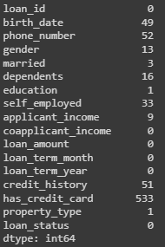
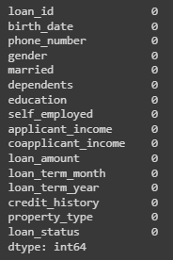

Missing Values
Tahapan Code
I removed the column "has_credit_card" due to the significant amount of null data, as it would have an impact on the final results of the data analysis.
Before
After

Slide 8
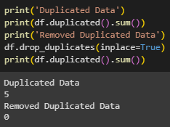
Handling Duplicated
Data
Code
I performed the removal of duplicate data to prevent it from affecting the final results.

Slide 9
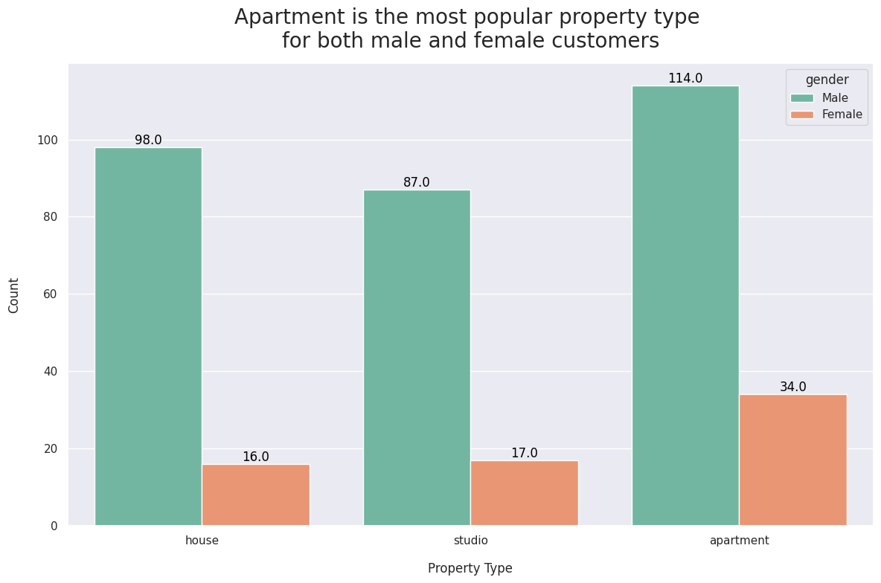
Business Insight
Apartment
Male : 114
Female : 34
Total : 148
House
Male : 98
Female : 16
Total : 114
Studio
Apartments are the preferred property choice for both male and female customers, followed by houses, and the least preferred property by customers is studios.
Male : 87
Female : 17
Total : 104

Slide 10
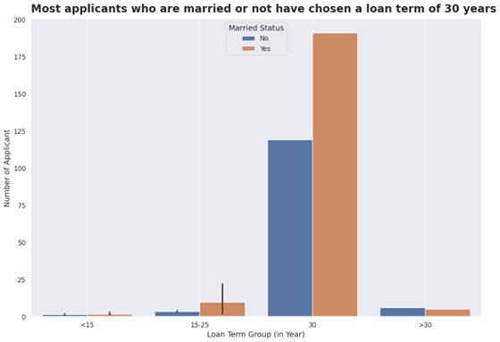
Business Insight
Loan Term
Looking at the data, most customers choose a credit term of 30 years, whether they are married or unmarried, because at that time it is likely to align with the customers' economic capabilities.

Slide 11
Based on the observations conducted, it can be concluded that the behavior of the majority of customers is male with an average age of >30 years, married status, and the majority of them choose a credit term of 30 years. This is likely because married individuals require credit for daily living expenses such as housing compared to unmarried individuals.
Conclusion

Slide 12
Dataset after EDA and the results.
For more details of the analyze data
click here

Slide 13

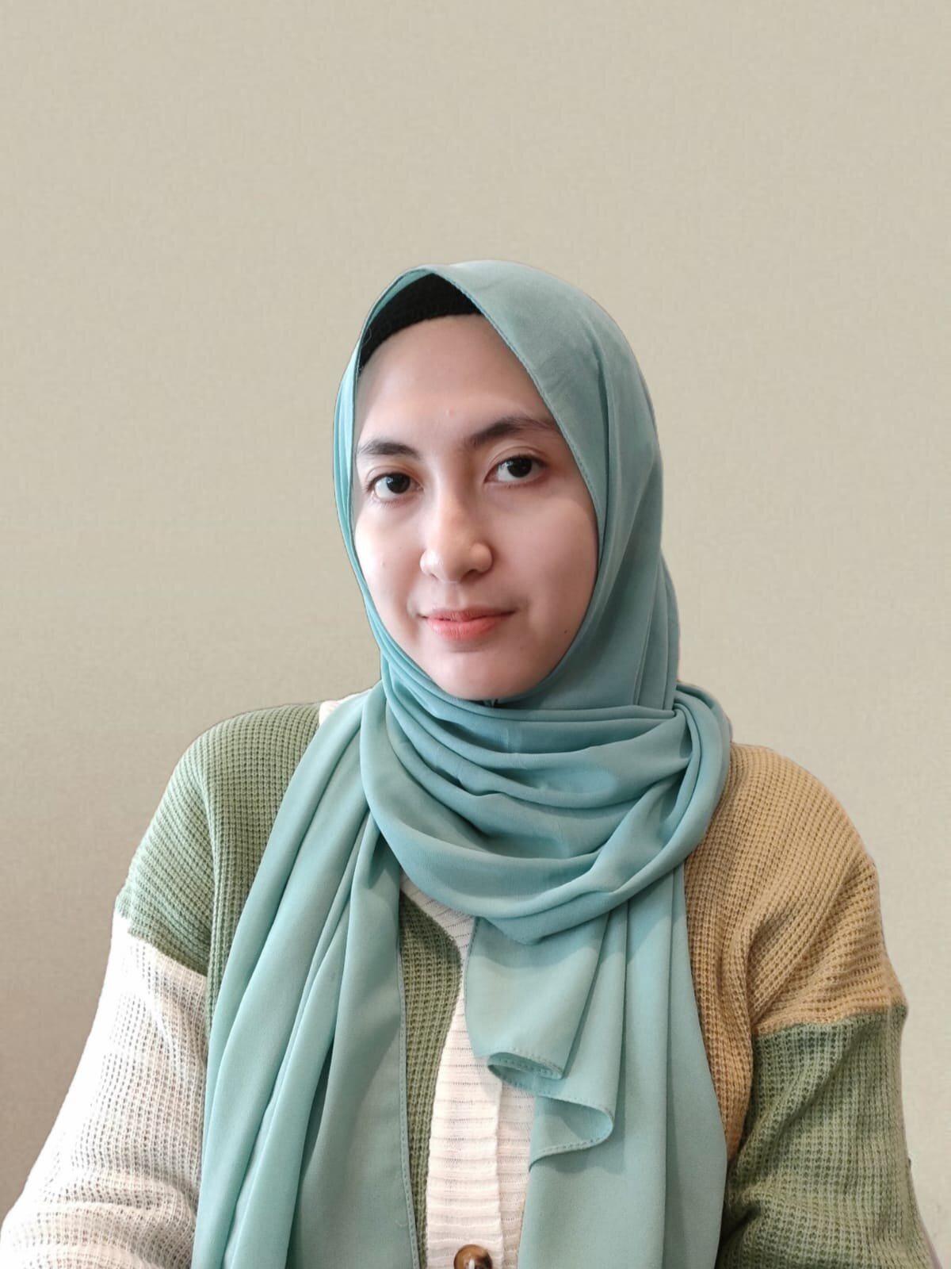
MY PROFILE
Hello everyone, my name is Rica Kesuma Mansyur. I graduated with a degree in Sociology Education from Universitas Negeri Jakarta. Although my major may not be directly related, I have worked on several projects and built a portfolio as a data analyst and data scientist through Rakamin Academy and Narasio Data. As a result, I have acquired knowledge in SQL and Python programming languages, as well as various data tools such as PostgreSQL, Google Colab, Jupyter, Dbeaver, Microsoft Excel, and Tableau.
RICA KESUMA MANSYUR
DATA ANALYST

Slide 14
Thanks!
Reach me on Linkedin
Rica Kesuma Mansyur
Please keep this slide for attribution.

